Slide 1

Team 7 Case Analysis
Meta
AIS 4099 Senior Capstone
Bre Franco, Stephan Ivester, Scott North

Slide 2

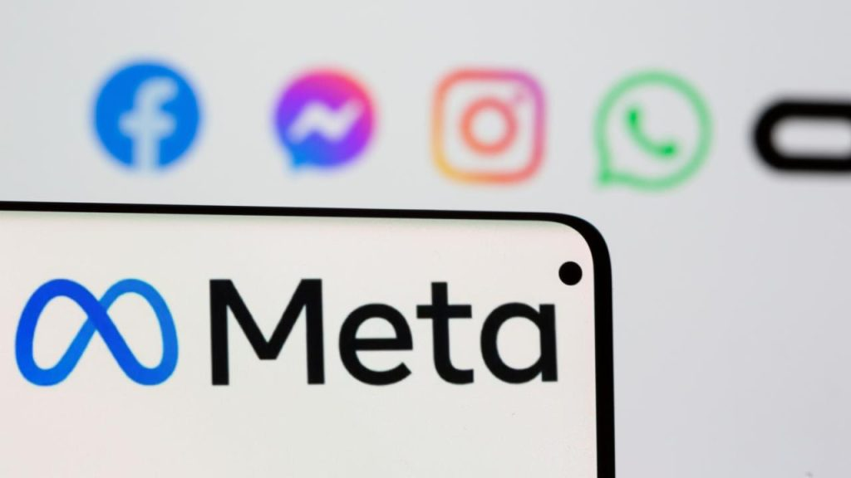
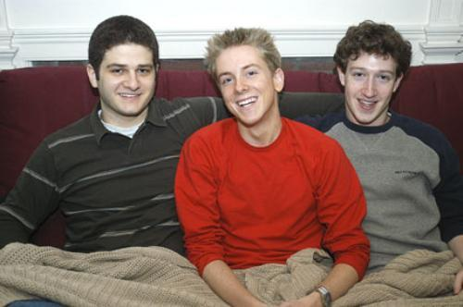

Introduction of Meta
$41 Billion Evaluation
Facebook is renamed Meta
2004
2016
2010
2021
Zuckerberg and roommates
start The Facebook
Nearly 2 Billion
People per month

Slide 3
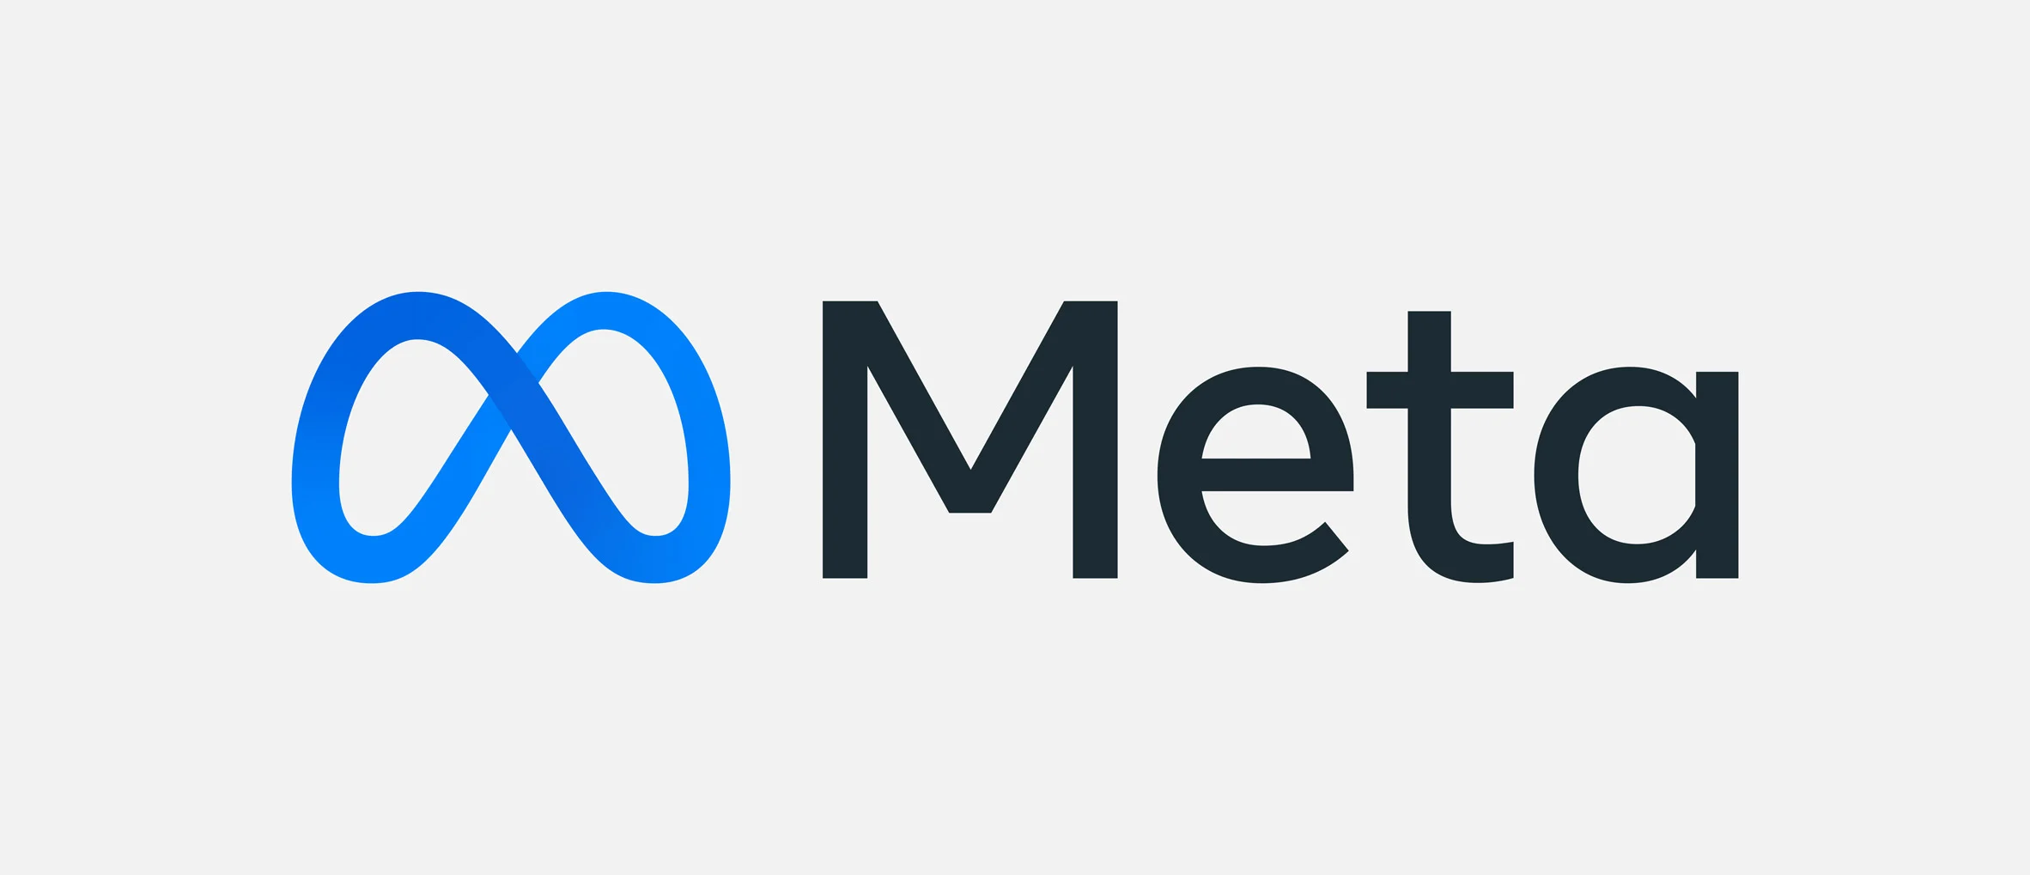

Problem Statement
As Meta's business model pivots to develop the Metaverse, the company faces the challenges of maintaining a positive company culture and boosting morale.
Notes:
Threats to these goals include the high degree of burnout experienced by tech industry workers, ideological differences regarding the company's new direction, and changing leadership, especially following the resignation of former COO Sheryl Sandberg

Slide 4

Communication Strategies
Internal values:
  "move fast"
  "build awesome things"
  "live in the future”
Employees are called “metamates”

Slide 5

Leadership
Organizational challenges:
  Lateral movement of employees to other departments
  Reporting to newly installed leaders
  Changes in executive leadership

Slide 6

Financial Sustainability
Points of concern:
  $10 billion loss in revenue from digital ad business
  Declining stock price
  Year-to-year report showing losses in
    Net income
    Diluted EPS
    Net profit margin
    Operating income
    Net change in cash

Slide 7

Literature Review #1
“ResearchED: Here’s Why Silicon Valley Employees Are Quitting Their Jobs” by Charlotte Mondal
  Increase in stress after move to remote work
  Desire for more flexibility
  Need for more control in professional lives

Slide 8

Literature Review #2
“More Than Two-Thirds of Big Tech Employees Feeling Burnout At Home” by Frank Konkel
  Survey data from 2020
  68% of Big Tech workers more stressed after move to remote work
  81% of Facebook employees felt more workplace stress after the pandemic

Slide 9

Literature Review #3
“Drained Minds Seek Relief from Silicon Valley Stress” by Quentin Hardy
  Many big tech workers seek professional help due to work stress
  Long working hours impair human development

Slide 10

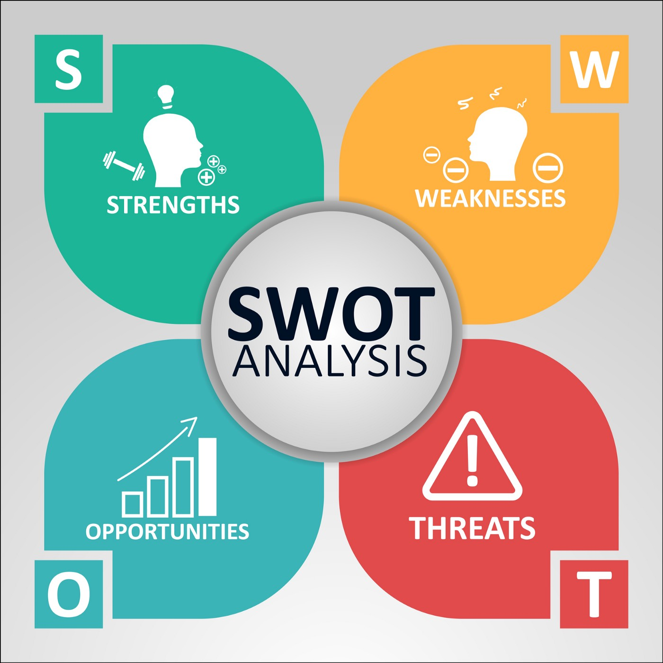

SWOT Analysis (Strengths)
Market Relevancy
  Recognized as a pioneer in the social media space
  2.936 billion monthly active users across its social media platforms (Kemp 2022)
Resource Capital
  Reported 7.5-billion-dollar net income in April of 2022 (Rodriguez 2022)
  Vast number of assets
Service Diversification
  Hold ownership in a total of 94 companies
  Facebook, Instagram, WhatsApp, Oculus VR Etc.

Slide 11

SWOT Analysis (Weaknesses)
Executive Turnover/Employee Burnout
  COO Sheryl Sandberg resignation
  "Increasingly burned out and disconnected from the mega-business she was instrumental in building" Rodrigues, Glazer, Seetharaman, & Horwitz, 2022).
Public Scrutiny
  2018 lawsuit
  Acting attorney general of The District of Columbia Karl Racine alleged that the company engaged in lax oversight of user data (McKinnon 2022).
  Weakening transparency led to lacks in public perception.

Slide 12

SWOT Analysis (Opportunities)
Expansion
  7.5-Billion-dollar net income in April of 2022
  Profitable income can be utilized to expand to new markets and services
  New technology initiatives
  Add to list of 94 acquired company's
Enhancement of Company Culture
  Investment in internal employee retention programs
  Employee development programs
  Internal hiring practices
Leadership Development
  One on one young executive mentorship initiatives
  Routine staff training seminars
  Executive workshops

Slide 13

SWOT Analysis (Threats)
Competition
  Crowded technology market (new entrants)
  Fast mobilization of the popular social media company, TikTok
  Estimated one billion global users acquired, in just two years, (Kemp 2022)
The Great Resignation
  Migration of workforce to other fields of profession.
  According to Intelligence Insider, “Only 16% of IT workers ages 19 to 29 plan to remain in their jobs, versus 48% of workers in the 50- to 70-year-old segment.”
Technology Burnout
  Detailed upkeep and time investment into tech requires major employee dedication.
  Unfulfillment in times of stagnant tech developmental periods.

Slide 14
Recommendations
Leverage Strengths
Deep pockets
Increase wages
Increase 401k
Leverage Opportunities
Known for excellent employee perks
Continue to attract top talent
Avoid complacency in providing attractive benefits

Slide 15
Recommendations
Mitigate Weaknesses
Weakness
Restructure employee wellbeing programs
Appointment of board of directors to oversee such programs
Mitigate Threats
Threat
Innovation initiatives
Utilize resource capital for service enhancement and product development.
Provide structures for worklife balance
Eliminate avenues of stress & outdated strategies

Slide 16

Conclusion
Meta faces unique and unprecedented opportunities
Through strategies of mitigation, advancement, and growth
Adhering to practices of...
Employee investment, staff wellbeing programs, board oversight committees and innovation initiatives

Slide 17

Horwitz, Jeff, et al. “Why Sheryl Sandberg Quit Facebook's Meta.” The Wall Street Journal, Dow Jones & Company, 4 June 2022, https://www.wsj.com/articles/why-sheryl-sandberg-quit-facebook-meta-11654215712.
Kemp, Simon. “The Latest Facebook Statistics: Everything You Need to Know - Datareportal – Global Digital Insights.” DataReportal, 11 May 2022, https://datareportal.com/essential-facebook- stats#:~:text=Facebook%20had%202.936%20billion%20monthly,'active'%20social%20media%20platforms.
McKinnon, John. “Meta's Mark Zuckerberg Is Sued by Washington, D.C., Attorney General.” The Wall Street Journal, Dow Jones & Company, 23 May 2022, https://www.wsj.com/articles/metas-mark-zuckerberg-is-sued-by-washington-d-c-attorney-general-11653329482.
Rodriguez, Salvador. “Facebook Revenue Slows but User Gains Boost Stock.” The Wall Street Journal, Dow Jones & Company, 28 Apr. 2022, https://www.wsj.com/articles/meta-platforms-facebook-fb-q1-earnings-report-2022-11651022191.
Sevilla, Gadjo. “The Great Resignation Is Disrupting the Tech Industry.” Insider Intelligence, Insider Intelligence, 11 Mar. 2022, https://www.emarketer.com/content/great-resignation-disrupting-tech-industry.
Kamau, Shalom. “Facebook Benefits: Perks of Working at Facebook.” Career Karma, 17 Jan. 2022, careerkarma.com/blog/facebook-benefits.

